Slide 1
A DEEP LEARNING APPROACH TO FAKE NEWS DETECTION
Sangamitra Balakumarasenthil, Dharshani Anandkumar
Deep Learning Presentation

Slide 2
Introduction
Problem Statement: Fake news undermines public trust and can influence elections, health decisions, and social stability.
Current Challenge: Manual detection is slow and subjective; scalable AI-based systems are needed to handle large-scale misinformation.
Goal: Build a deep learning-based model that classifies news headlines as real or fake using natural language features.

Slide 3
Background
NLP and deep learning have shown success in text classification tasks.
Models like BiLSTM, GRU, and CNN are effective in capturing semantic patterns in short texts.
Our Contribution: Benchmark and compare multiple deep learning models on a labeled fake news dataset using only headline input.

Slide 4
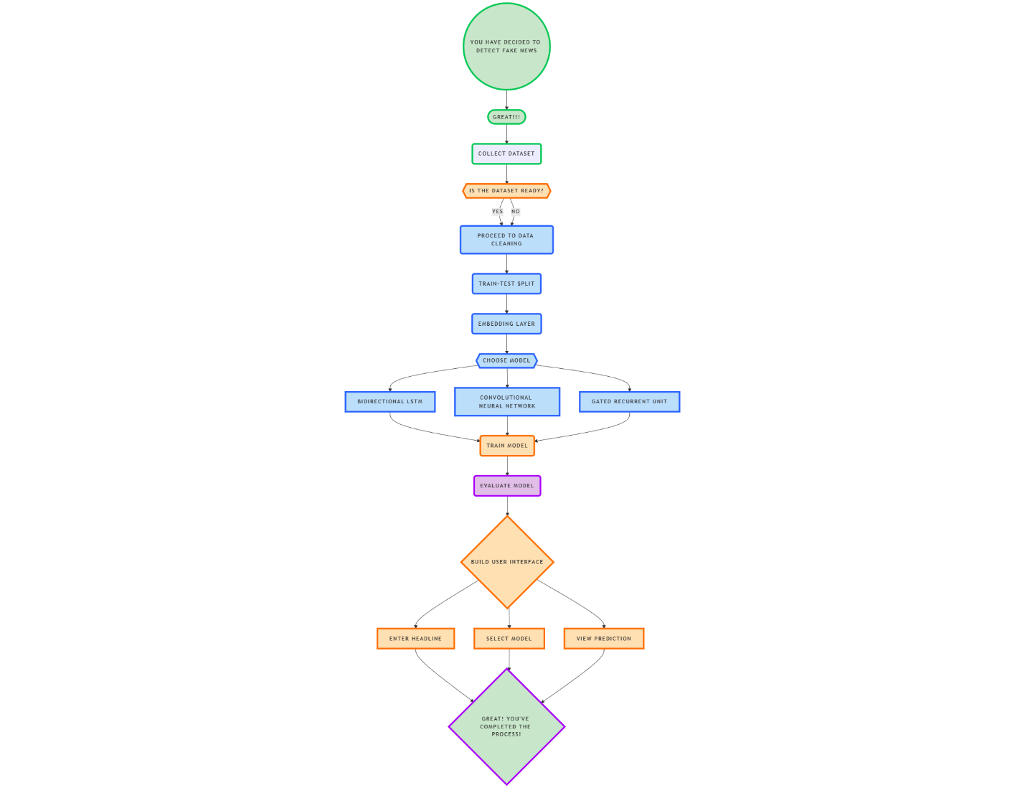
Methodology
Pipeline Overview:
Dataset Collection: Merge True.csv and Fake.csv
Text Preprocessing: Clean, tokenize, and pad headline text
Train-Test Split: 80% train, 20% test
Model Selection: BiLSTM, GRU, CNN
Model Training: 6 epochs, binary cross entropy
Evaluation: Accuracy, Precision, Recall, F1-score
User Interface: Gradio-based prediction interface

Slide 5
Dataset and Preprocessing
Dataset: Balanced mix of real and fake headlines
Cleaning Steps:
Lowercasing
Punctuation & special character removal
Tokenization using Keras
Padding (max_len = 25)
Vocabulary Size: 10,000 words
Split: 80% train, 20% test

Slide 6
Model Architectures
BiLSTM: Bidirectional LSTM for full sequence context
GRU: Lightweight recurrent unit with fewer parameters
CNN: 1D convolutional layers to capture local patterns
All models use:
Embedding layer (128D)
Dropout (0.5)
Sigmoid-activated dense output
Hyperparameters and Training
Optimizer: Adam
Loss: Binary Cross Entropy
Epochs: 6
Batch Size: 64
Dropout: 0.5
Metric: Accuracy

Slide 7
Evaluation Metrics
Accuracy reflects the overall correctness of the model by measuring the proportion of all correctly classified instances.
Precision measures how many of the samples predicted as fake were actually fake, which is crucial when minimizing false alarms.
Recall evaluates the model’s ability to identify actual fake news correctly, helping to measure how well the model reduces missed detections.
F1-score, the harmonic mean of precision and recall, provides a balanced view, especially when class distribution is not perfectly equal.
Metrics Used:
Accuracy
Precision
Recall
F1-Score
Confusion Matrix
High recall is essential in fake news detection because it reduces the risk of harmful misinformation being missed by the system.

Slide 8
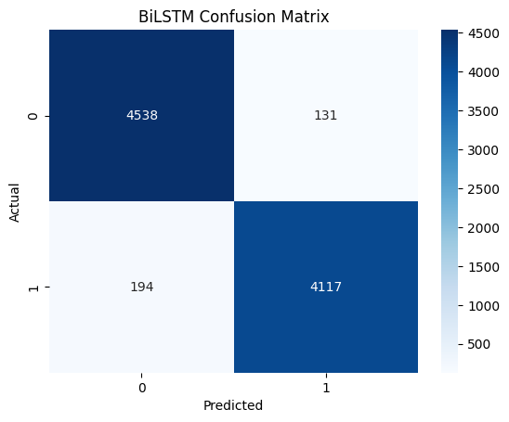
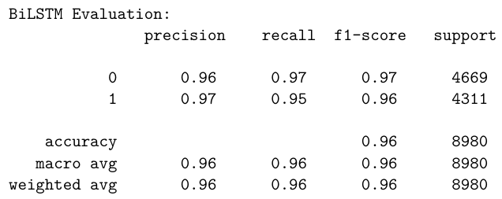
Results: BiLSTM
Accuracy: 92.3%
Precision (Fake): 91.91%
Recall (Fake): 92.64%
Insight: Balanced performance, best overall classifier
Handles context well due to bidirectional LSTM layers

Slide 9

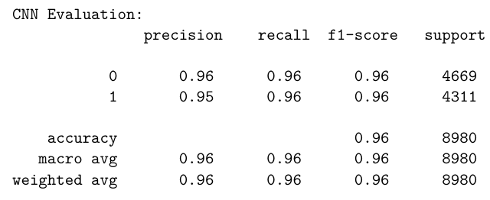
Results: CNN
Accuracy: 89.16%
Precision: 89.65%
Recall: 88.35%
Insight: Fast and efficient
Slightly weaker recall; good for real-time prediction with trade-offs

Slide 10

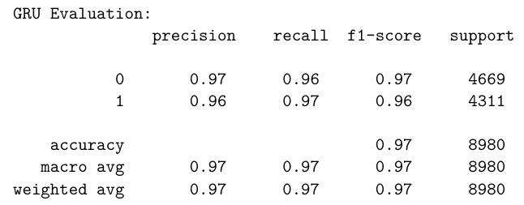
Results: GRU
Accuracy: 91.69%
Precision: 91.93%
Recall: 91.26%
Insight: Nearly as good as BiLSTM with fewer parameters
Suitable for mobile/embedded deployment

Slide 11
Conclusion
Deep learning models can classify fake vs. real headlines with high accuracy.
BiLSTM is most accurate; GRU is efficient for deployment.
CNN is lightweight but trades off some performance.

Slide 12
Future Work
Expand to full-text articles, not just headlines
Add explainability tools (e.g., attention layers, SHAP)
Deploy on real-time dashboards or social platforms
Extend to multilingual fake news detection

